Slide 1
Analyze survey data (Project)
Student Name: Temirlan Karataev
Program: Misk Nanodegree program – Data Analysist

Slide 2
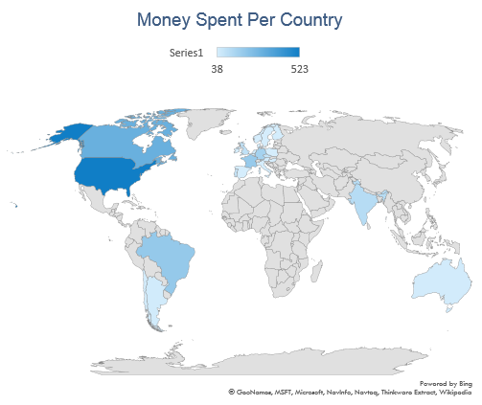
Amount of money spent in purchases per country
As we can see on the filled map, USA has the largest spent of any country. After Canada, no other country spends even close to the amount of the USA.
Money
Spent in USD
SQL Code
SELECT BillingCountry,
SUM(il.Quantity * il.UnitPrice) Amount_spent_usd FROM Invoice i
JOIN InvoiceLine il
ON i.InvoiceId = il.InvoiceId
GROUP BY 1 ORDER BY 2 DESC;

Slide 3
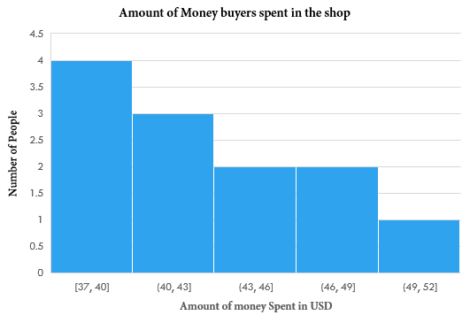
purchasing power of buyers
The Histogram on the left is a right-skewed. Therefore, the median is less than the mean. Also, we can see that there’s an agglomeration at the first telling that most buyers spend between 37 – 30 USD in purchases. These data helps the seller to sell less for more in that range.
SQL Code
SELECT c.CustomerId ,c.FirstName, c.LastName , sum(i.Total) Money_spent
FROM Invoice i
JOIN Customer c
ON c.CustomerId = i.CustomerId
GROUP BY 1 ORDER BY 4 DESC;
(*With the help of pivot table in excel)

Slide 4
Top 10 earning Artists
The cluster chart illustrates the top ten earned artists names with IDs. The first three artists earned below 50$. Constantly, the three artists in the middle earned less than 100$. Finally, the last two earned more than 100$.
SQL Code
SELECT a.ArtistId, a.Name, SUM(il.Quantity * il.UnitPrice) Amount_of_money_earned
FROM Artist a
JOIN Album al ON a.ArtistId = al.ArtistId
JOIN Track t ON t.AlbumId = al.AlbumId
JOIN Genre g ON g.GenreId = t.GenreId
JOIN InvoiceLine il ON il.TrackId = t.TrackId
Group by 1 ORDER BY 3 DESC LIMIT 10;

Slide 5
What type of genre music does customers like the most?
The pie chart represents the top genre music that customers like the most. As we can see that Rock music takes is the most liked by customers. While Latin, Metal along with Alternative & punk music takes one third from the whole. Lastly, all of the other genre types combined are represented in less than quarter of the pie.
SQL Code
SELECT g.name, COUNT(i.InvoiceId) Number_of_purchases FROM Invoice i
JOIN InvoiceLine il ON il.InvoiceId = i.InvoiceId
JOIN Track t ON t.TrackId = il.TrackId
JOIN Genre g ON g.GenreId = t.GenreId
GROUP BY 1 ORDER BY 2 DESC;

